Slide 1
Module 2 SQL Subtotal Operators
Lesson 1: GROUP BY Clause Review
Notes:
Welcome to Lesson 1 of Module 2 on SQL subtotal operators
Opening question:
What is the essential difference between pivot table results and GROUP BY results?
GROUP BY just computes the cell values not axis summaries or subtotals
GROUP BY does not show missing values. Data cubes show missing values.
What is an advantage of the GROUP BY clause compared to pivot tables? No sparsity

Slide 2
Lesson Objectives
Review GROUP BY clause
Compare GROUP BY results with pivot table
Understand the importance of the subtotal operators
Notes:
Objectives:
Understand the motivation for the subtotal operators
Review GROUP BY usage
Compare GROUP BY result with pivot table

Slide 3
GROUP BY Clause Review
Row summary
One row per combination of grouping values
Grouping columns, summary values
Aggregate function
One value per set of rows
MIN, MAX, COUNT, SUM, AVG, …
Notes:
Should have covered GROUP BY clause in a first database course:
Important question in query formulation:
Problem statement involves row results or group results
Look for aggregate functions mentioned in the result or conditions to test

Slide 4
GROUP BY Rules
SELECT/GROUP BY consistency
SELECT Col₁, Col₂, …, Col_{n}, COUNT(*)
Condition placement
Row conditions (no aggregate function) in WHERE
Group conditions (aggregate function) in HAVING
GROUP BY Col₁, Col₂, …, Col_{n}
Notes:
SELECT/GROUP BY consistency
SELECT list contains grouping columns and aggregate calculations
GROUP BY must contain all grouping columns
Row conditions
No aggregate functions in conditions
GROUP conditions: aggregate function on at least one side of condition

Slide 5
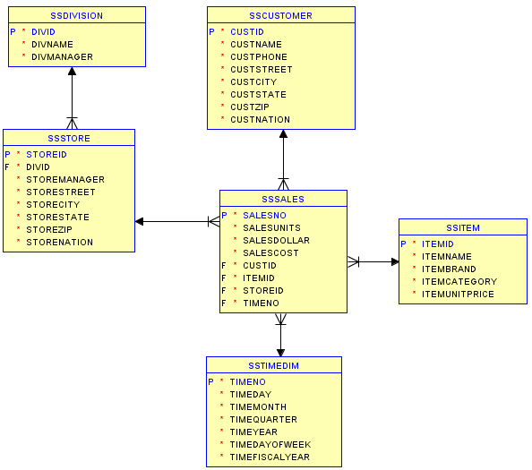
Oracle Diagram for the Store Sales Tables
Notes:
Used in slide examples and practice problems
Tables prefixed with SS (SSCustomer) in examples because of conflicting table names in Oracle schema.
Typical query involves joins of fact and one or more dimension tables followed by grouping and aggregate function calculation

Slide 6
GROUP BY Example
Summarize (sum, min, and count) store sales for USA and Canada in 2016 by store zip and month
Only include groups with more than one row
SELECT StoreZip, TimeMonth,
SUM(SalesDollar) AS SumSales,
MIN(SalesDollar) AS MinSales, COUNT(*) AS RowCount
FROM SSSales, SSStore, SSTimeDim
WHERE SSSales.StoreId = SSStore.StoreId
AND SSSales.TimeNo = SSTimeDim.TimeNo
AND (StoreNation = 'USA' OR StoreNation = 'Canada')
AND TimeYear = 2016
GROUP BY StoreZip, TimeMonth
HAVING COUNT(*) > 1
ORDER BY StoreZip, TimeMonth;
Notes:
6
Summarize: sum, min, and count
Problem statement: Retrieve zip code, month, and sum of the sales for USA and Canadian stores in 2016
One row per combination of store zip code and month
Each row contains grouping columns and aggregate calculations
Must use both StoreZip and TimeMonth in the group by because these columns are not aggregate functions

Slide 7
Query Clause Evaluation Order
Rows
FROM
Groups
GROUP BY
WHERE
HAVING
Result
ORDER BY
SELECT
Notes:
Step 1: FROM clause (cross product and join operators)
Step 2: WHERE clause (row conditions)
Step 3: GROUP BY clause (sort on grouping columns, compute aggregrates)
Step 4: HAVING clause (group conditions)
Step 5: ORDER BY clause
Step 6: eliminate columns not in SELECT (projection operation)

Slide 8
Lessons about the Evaluation Order
Row operations before group operations
FROM and WHERE before GROUP BY and HAVING
Check row operations first
Grouping occurs only one time
Notes:
Conceptual evaluation process:
- Sequence of steps to evaluate a SELECT statement
- Conceptual not actual: DBMSs use many shortcuts
Row operations occur first
- Errors in formulation usually occur in row operations
- Use small tables to understand relationship of row operations (FROM, WHERE) to
group operations (GROUP, HAVING)
- For large problems, execute row operations separately to ensure that results
before grouping are what you expect
Grouping only occurs one time: only an issue for advanced problems when summarizing on independent columns

Slide 9
Motivation for Subtotal Extensions
Lack of subtotals in GROUP BY result
Show subtotals in a data cube
Provide control over subtotals in GROUP BY result
Provide a bridge between relational database representation and data cubes
Notes:
9
Only subtotals in GROUP BY involve the grouping columns (lowest level totals)
GROUP BY clause is extended with several subtotal operators
Subtotal operators are not strictly necessary but they are convenient.
More precise name is axis summary operators.
Subtotal operators can be used indirectly by pivot table tools. Optimizing SQL compiler can efficiently generate.

Slide 10
GROUP BY / Pivot Table Comparison
GROUP BY result
Sales Pivot Table
State | Month | SUM(Sales)
CA | Dec | 100
CA | Feb | 75
CO | Dec | 150
CO | Jan | 100
CO | Feb | 200
CN | Dec | 50
CN | Jan | 75
State | Month
 | Dec | Jan | Feb | Total
CA | 100 | - | 75 | 175
CO | 150 | 100 | 200 | 450
CN | 50 | 75 | - | 125
Total | 300 | 175 | 275 | 750
SELECT State, Month, SUM(Sales)
GROUP BY State, Month
Notes:
10
Result: maximum of N × M rows. Usually less than N × M rows because of missing values. For example, do not have monthly sales in all states. More sparsity for finely grained fact tables.
Differences
Missing values
Axis summaries or subtotals

Slide 11
Summary
GROUP BY clause to calculate summary data for decision making
Extend GROUP BY with subtotal operators
Differences between GROUP BY results and pivot tables
Notes:
Original SQL design
GROUP BY for summary data calculation
Conceptually, summary calculations after row calculations
Differences
Missing values: data cubes have missing values (empty cells) while GROUP BY does not show missing values
Subtotals: data cubes show all subtotals (row, column, grand total for 2 dimensions) while GROUP BY only shows cell values.
Extend GROUP BY to calculate subtotals
SQL extensions support computation of subtotals. Other parts of Unit 4 provide details about subtotal operators
CUBE
ROLLUP
GROUPING SETS
Analytic function extensions
Apply functions to GROUP BY results
Needed for common decision support calculations such as rankings, moving averages, and ratio to totals

